Slide 1
Introduction to Data Science
Machine Learning in Data Science: Hands-On Python

Slide 2


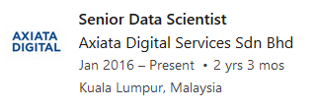
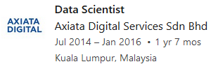
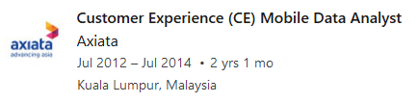
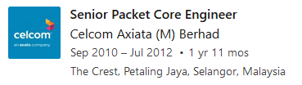
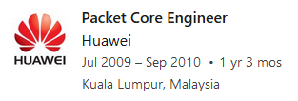
About Me
Aswadi Abdul Rahman
aswadi.abdulrahman@gmail.com
https://www.linkedin.com/in/aswadiabdulrahman/
Some Working Experiences

Slide 3
Introduction to Git
Formal version control system
Developed by Linus Torvalds (developer of Linux)
used to manage the source code for Linux
Tracks any content (but mostly plain text files)
source code
data analysis projects
manuscripts
websites
presentations

Slide 4
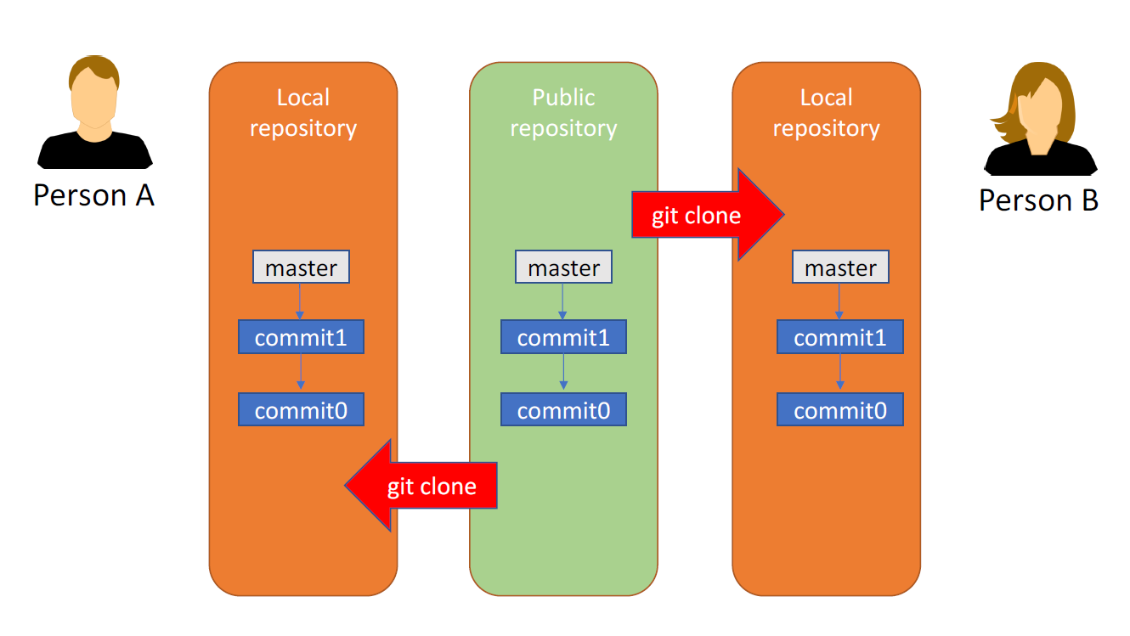
Introduction to Git
Install git from https://git-scm.com/downloads
Go to directory that you want to put the material using terminal.
Git clone https://github.com/gulstein86/Automatic-URL-Classifier.git

Slide 5
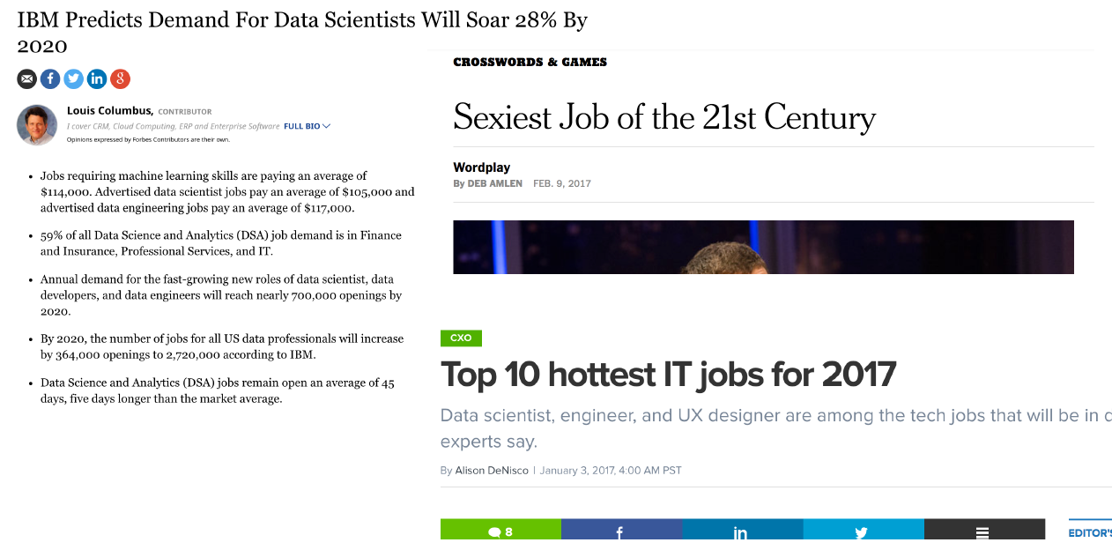
Why are we here?
Data scientists are high in demand

Slide 6
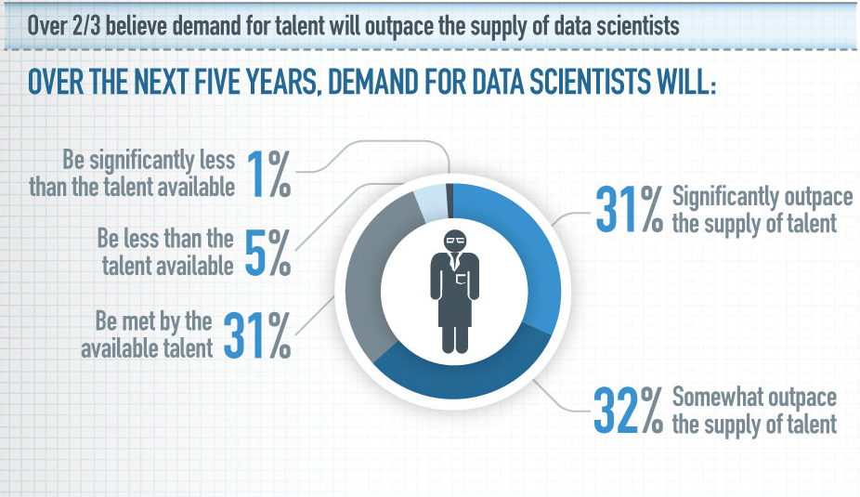
Why are we here?
Demand will outpace the supply

Slide 7
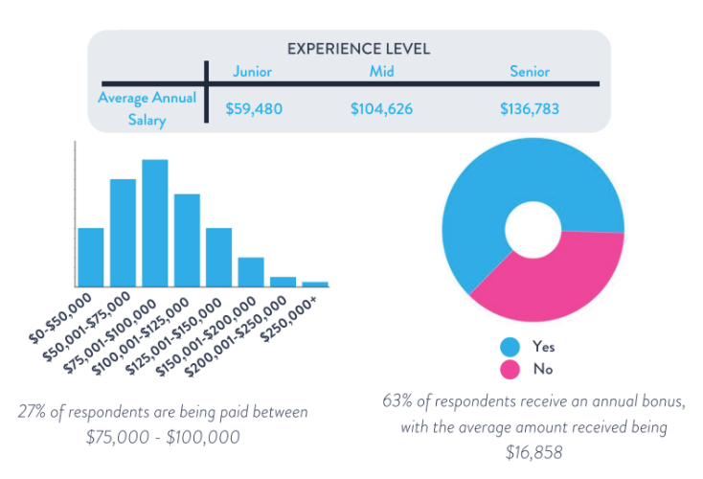
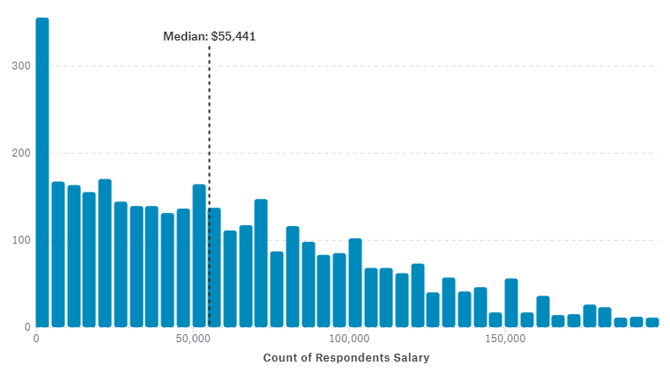
Why are we here?
Pays well
Min: RM 23K /month
Source: http://www.bigcloud.io/salary-survey/
Source: https://www.kaggle.com/surveys/2017

Slide 8
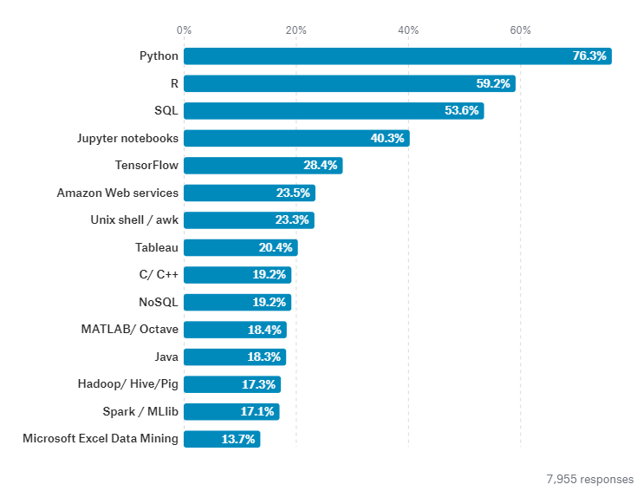
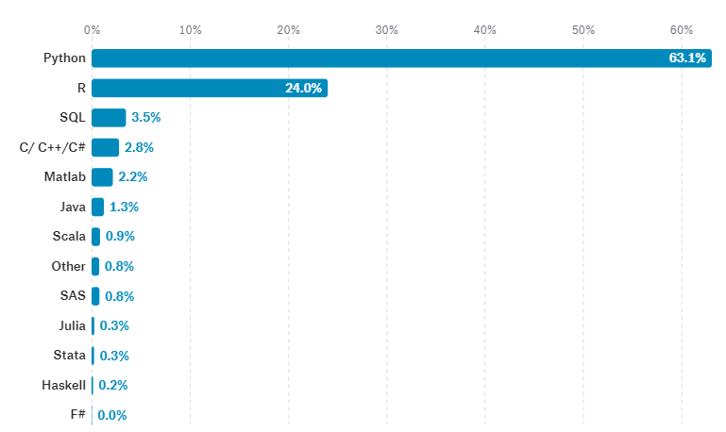
Why we use python?
Python was the most commonly used data analysis tool across employed data scientists overall, but more Statisticians are still loyal to R.
Source: https://www.kaggle.com/surveys/2017
Everyone data scientist has an opinions on what language you should learn first. As it turns out, people who solely use Python or R feel like they made the right choice. But if you ask people that use both R and Python, they are twice as likely to recommend Python.

Slide 9
Data Science topic
Introduction to Data Science & Python
Data Acquisition and Wrangling
Applied Probability and Statistics
Applied Machine Learning
Big Data Analytics
Data Visualization and Storytelling

Slide 10
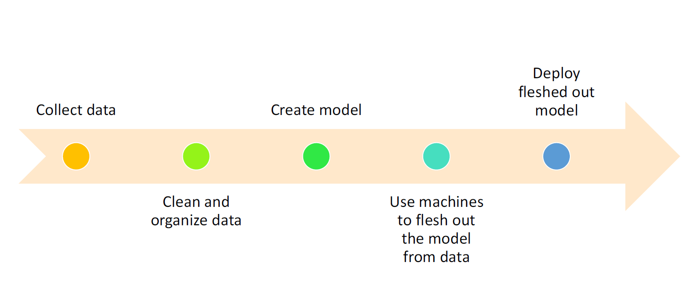
Step for deploying the model

Slide 11
List of available dataset
Kaggle Competition Website (https://www.kaggle.com/)
UC Irvine Machine Learning Repository (http://archive.ics.uci.edu/ml/)
Malaysia Open Data (http://www.data.gov.my/)
Singapore Open Data (https://data.gov.sg/)

Slide 12
This course is not..
About big data analytics tools and big data technologies
No: Tools such as SAS, SPSS, Cloudera, etc
Yes: Fundamental programming of Python
About statistical learning theory
No: Statistical proof and formulas
Yes: Some statistical theory is required
About specific industry domain
No: In depth discussions on Finance, Banking, BI etc
Yes: Some hands-on examples will be discussed

Slide 13
Software
For this whole course, the following software will be used:
Microsoft Windows OS
Anaconda, data science platform powered by Python (https://www.anaconda.com/download/)
Jupyter Notebook
Python
Git (https://git-scm.com/downloads)

